Slide 1
The new TED XML schema
Workshop on eForms for reusers of TED data
27 September 2022
Yves Jordan – TED unit – Publications Office of the EU

Slide 2
Agenda
Introduction
The new schema
Challenges & benefits for re-users
Available resources
Conclusion

Slide 3
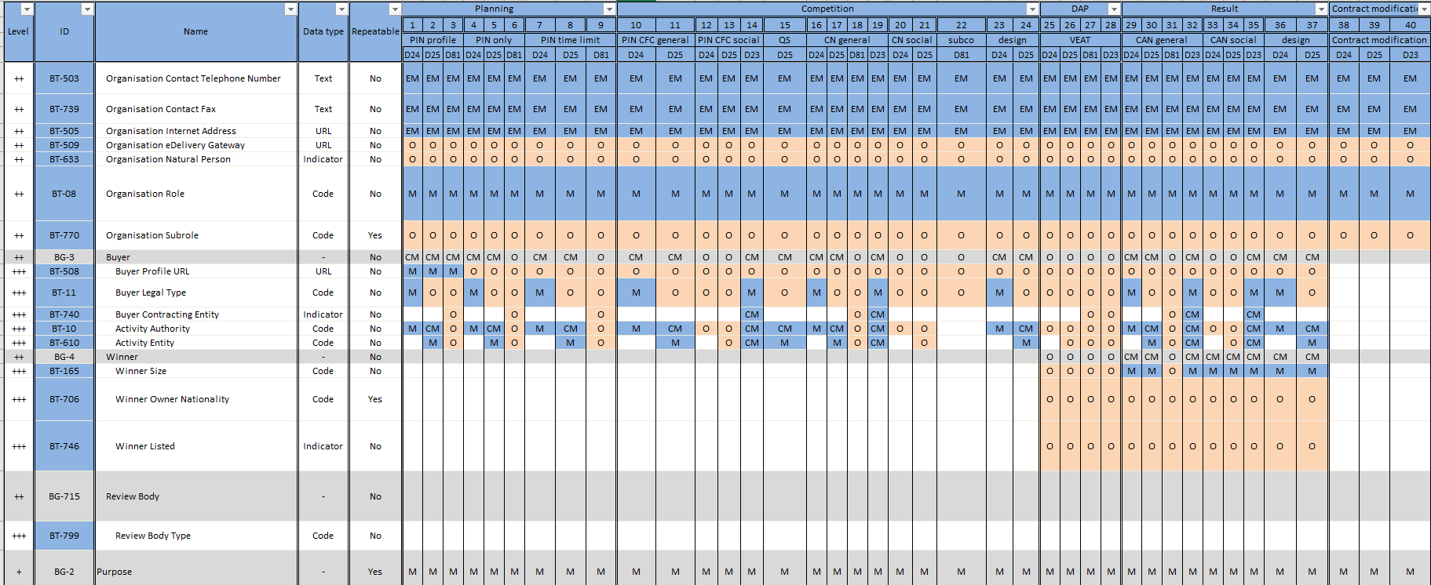
1. Introduction
Some of the Changes associated to the eForms Implementing Regulation
New concepts
  Introduction of Business Terms (BTs) & Business Groups (BGs)
  To support some EU policies (CVD, SME, …)
Conceptual changes
  Many elements now associated to the lot (e.g. Selection Criteria, Framework Agreement, Deadline Receipt Tenders, …)
  Further structured & detailed concepts (e.g. Award Criteria, Withholding information)
Rules
  Less permissive (e.g. “other” value not allowed anymore for CA Activity & CA Type)
  Additional Code based value check (for information that evolved from text to code)
  Numerous “co-constraint” rules (consistency between values for different fields)

Slide 4
2. The new schema a) The challenges
Have a format easily reusable
Address all the changes brought by the regulation (new concepts, structural changes)
Reduce maintenance associated risks
Increase stability
Reduce unnecessary repetitions

Slide 5
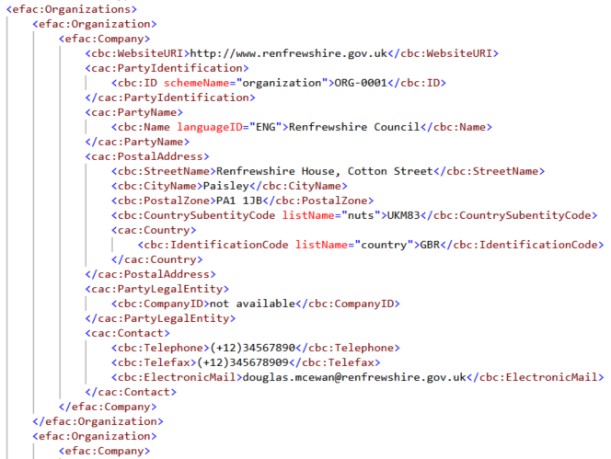
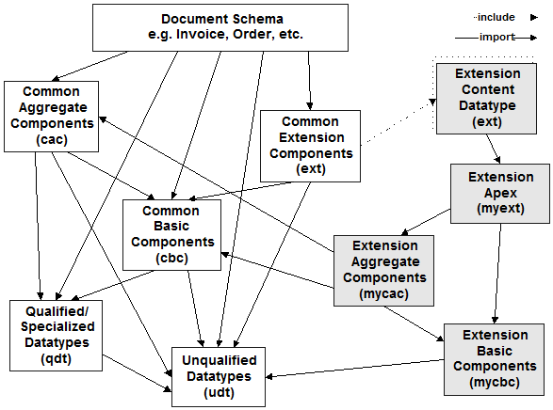
2. The new schema b) OASIS Universal Business Language
Open standard, royalty-free
Latest version: 2.3
ISO Standard (v. 2.1: ISO/IEC 19845:2015)
Highly semantic, XML based
Large Collection:
  1k basic information elements (BBIE),
  250+ Aggregated components (ABIE), and
  80+ Document types.
World widely developed and used (in the EU : ESPD, eInvoicing, BRIS, …)
Possibility to contribute
Extensibility & flexibility

Slide 6
2. The new schema c) Tailoring
Notice
Notice Metadata
Extensions
Tendering Terms
Tendering Terms
Tendering Process
Procurement Project
Procurement Project Lot
Tendering Process
Procurement Project
Procurement Project Lot
Tendering Terms
Tendering Process
Procurement Project
Use of 3 document types:
  Prior Information Notice
  Contract Notice
  Contract Award Notice
Definition of a new document type (UBL based & candidate for v2.4):
  Business Information
Flexibility:
  Reduction of the number of required elements with the use of codes
Extensibility
  Definition of own aggregate components to:
    Satisfy specific requirements
    Reduce repetition of information

Slide 7
2. The new schema d) Balance
More stable schema (common library, codes)
Controls moved outside the schema (XSD for lexical & structural validation)
Consistent mark-up across all notices
Quick appropriation (reuse, high semantic, few XSDs)
Reduction of repetition and associated errors (normalization, Multilingual text: repetition of text fields only)
Improved data quality (500+ rules implemented)
Increased semantic (726 fields defined for 409 Business Terms, more structured)
No text formatting

Slide 8
3. Challenges & benefits for reusers
Challenges:
  New concepts
  Structural changes
  Change of context for many Business Terms (Procedure -> Lot)
Benefits:
  More reliable search results
  More accurate Business Opportunities identification
  Quick appropriation
  More stable schemas

Slide 9
4. Available resources
Software Development Kit (SDK) resources:
  Schemas
  eForms XML examples
  Translations
  eForms Schema documentation
  XLST to convert TED-XML to eForms schema
TED XML schemas
UBL
eForms Implementing Regulation
eForms Policy Implementation Handbook
Ontology mapping (RML)

Slide 10
Thank you for your Attention
Any questions?
  ted@publications.europa.eu

