Slide 1
Retrieving eForms notices from TED portal
Workshop on eForms for reusers of TED data
27 September 2022
Carmelo Greco – TED unit – Publications Office of the EU

Slide 2
Agenda
Search for notices published on the TED portal
Retrieve notices published on the TED portal
View notices in various formats
Demo

Slide 3
Search for notices published on the TED portal
TED users will be able to search in both current standard forms and eForms notices
Several options to search for notices:
  Quick search.
  Advanced search.
  Expert search.
  TED website API.

Slide 4
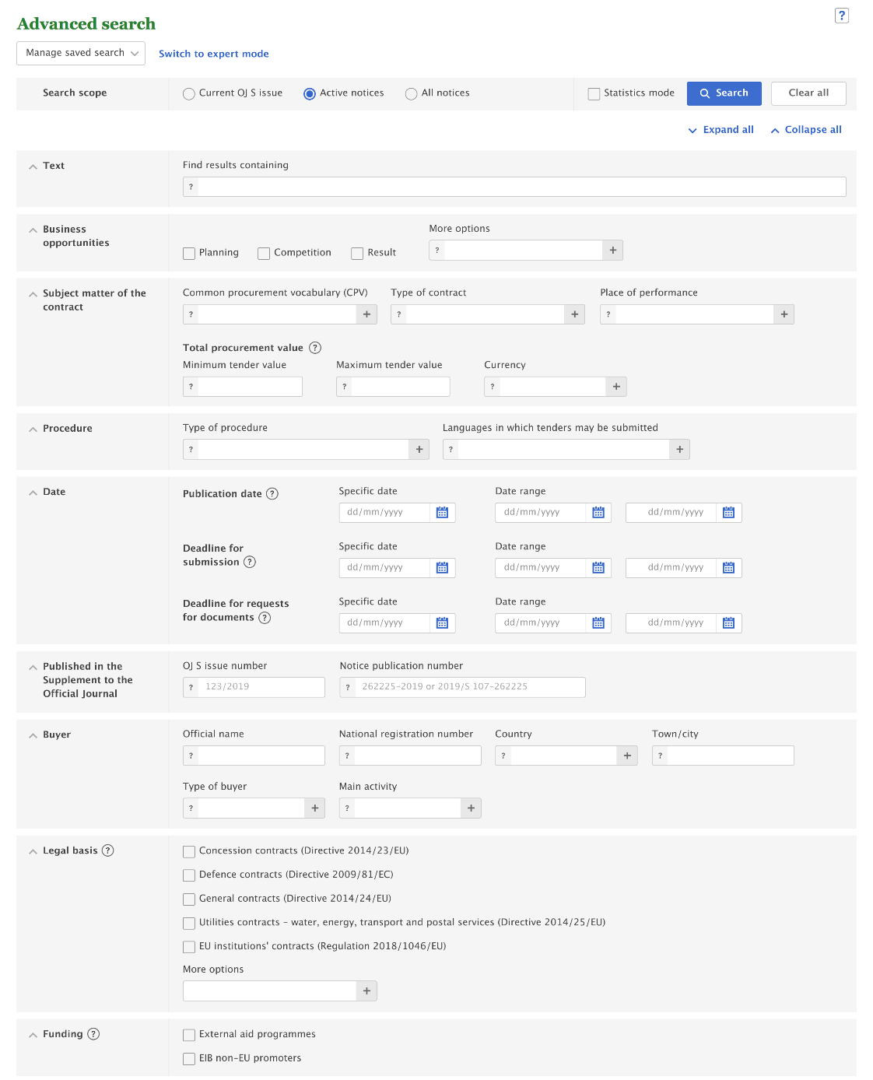
Changes in the advanced search
By default, search will be limited to the current search fields
Search codes will be based on the authority tables used
for eForms (e.g. notice type, legal basis, buyer legal type, etc.)
eForms values will be added in appropriate fields
For Business opportunities, the search field “notice type”
will be used instead of the field “document type”.
Values will be those of the authority table notice-type
on GitHub eForms-SDK.
‘Country’ and ‘Languages in which tenders may be submitted’:
use of 3-letter code instead of 2-letter code
Place of performance values displayed in a new tree
Type of buyer tree enhanced with eForms values and list of
international organisations
New “Funding” section to search for
“External aid programmes” and “EIB non-EU promoters”
Saved advanced searches will be migrated

Slide 5
Changes in the expert search
All current expert search fields will still be usable -> saved user queries will be maintained
Some codes will allow to find current standard form notices only:
  TD (Type of document); AC (Award criteria); TY (Type of Bid); RP (Regulation); HA (Heading A / European Institutions); RN(document backward reference)
Some codes will allow to find eForms notices only:
  award-criterion-type; notice-identifier; notice-version
Some new search fields will be used to find both standard form notices and eForms notices:
  notice-type; corporate-body; funding

Slide 6
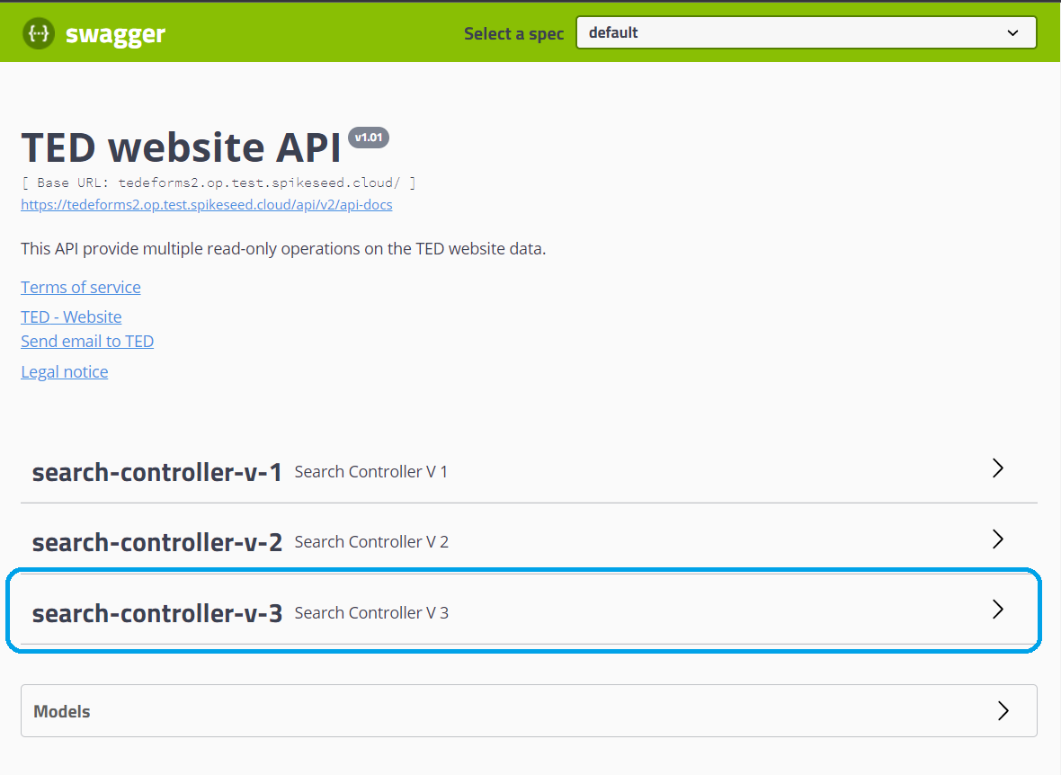
Changes in the TED website API
A new version (v3) of the TED website API will replace the version v2 which will be discontinued.
The search controller (v3) will provide the operations to search and retrieve both TED Standard forms notices and eForms notices.

Slide 7
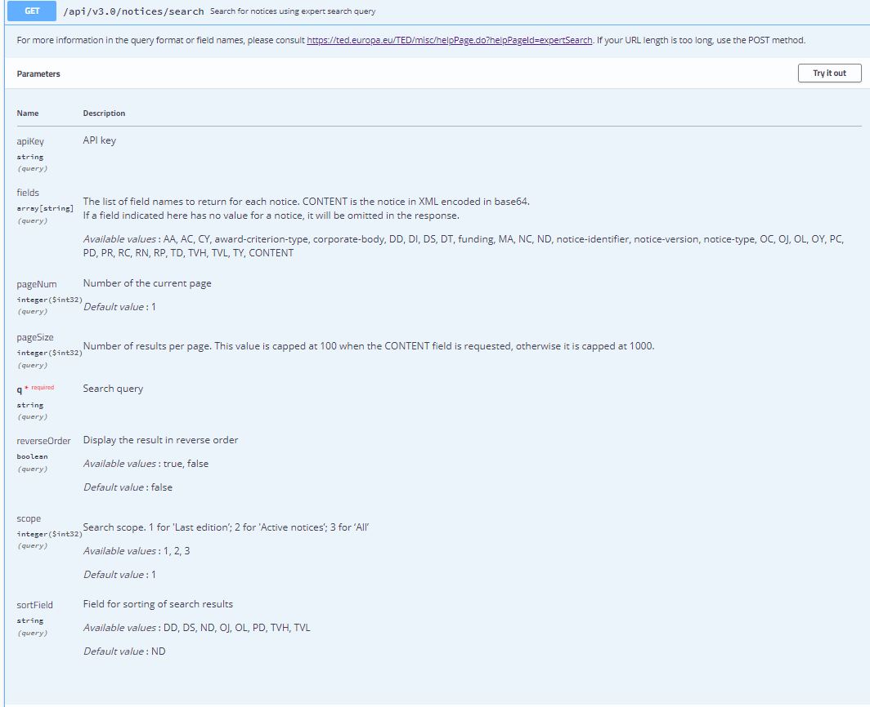
Searching notices with
TED website API
Main parameters
fields - To define the list of field names to return for each notice.
  Available values :
    AA, AC, CY, award-criterion-type, corporate-body, DD, DI, DS, DT, funding, MA, NC, ND, notice-identifier, notice-version, notice-type, OC, OJ, OL, OY, PC, PD, PR, RC, RN, RP, TD, TVH, TVL, TY, CONTENT
  CONTENT is used to retrieve the notice in XML encoded in base64.
q – The search query
  Expert search query expression to make a query
Scope – The search scope
  Values: 1 for 'Last edition’; 2 for 'Active notices’; 3 for ‘All notices’

Slide 8
Retrieve notices published on the TED portal
TED users will be able to retrieve in both current standard forms and eForms notices
Several options to retrieve notices:
  Direct links.
  Download XML notices in bulk from the TED website.
  Download XML notices in bulk from the TED FTP server.

Slide 9
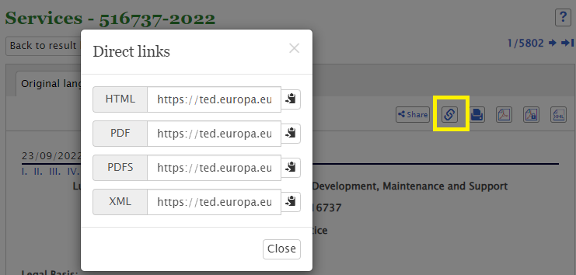
Retrieve notices using direct links
The UDL link contains:
the prefix:
  http://ted.europa.eu/udl?uri=TED:NOTICE:
- the document number
The view type:
  TEXT (notice view), PDF (PDF view), PDFS (signed PDF view in an official language), or XML (received notice in XML);
- The document language;
- The display type (always HTML).
Example of an UDL link: https://ted.europa.eu/udl?uri=TED:NOTICE:516737-2022:HTML:EN:HTML

Slide 10
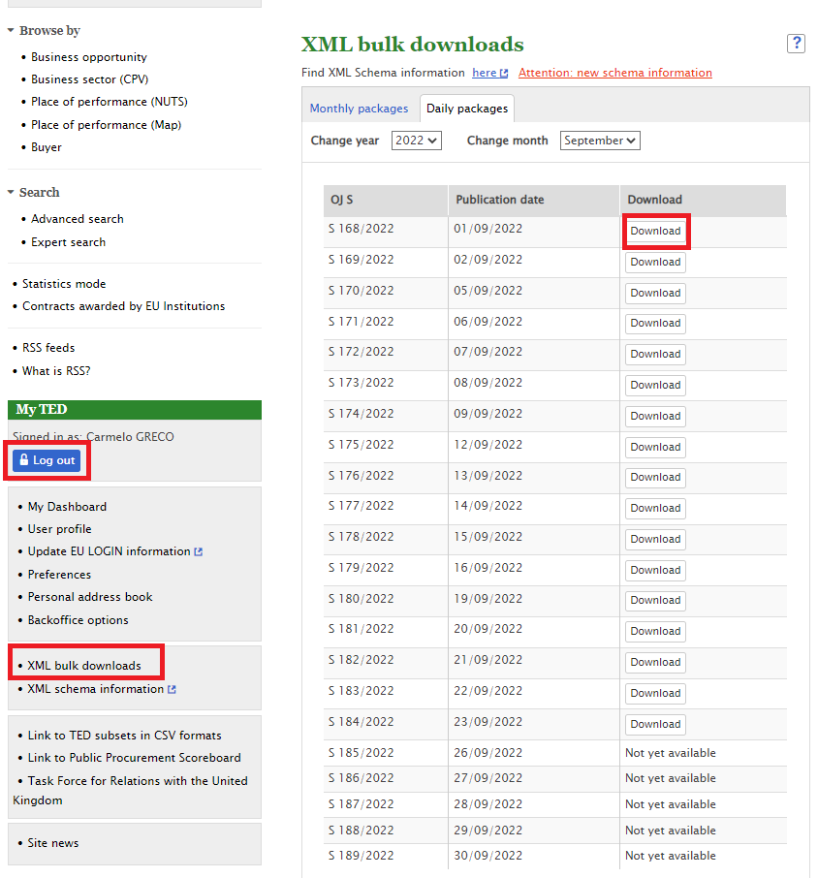
Download XML notices in bulk from the TED website.
you can download XML notices in bulk from the TED website.
Daily packages: archives containing all the notices for each day
Monthly packages: archives containing all the notices for each month
The user need to log in to access to the page
Link: https://ted.europa.eu/TED/misc/xmlPackagesDownload.do

Slide 11
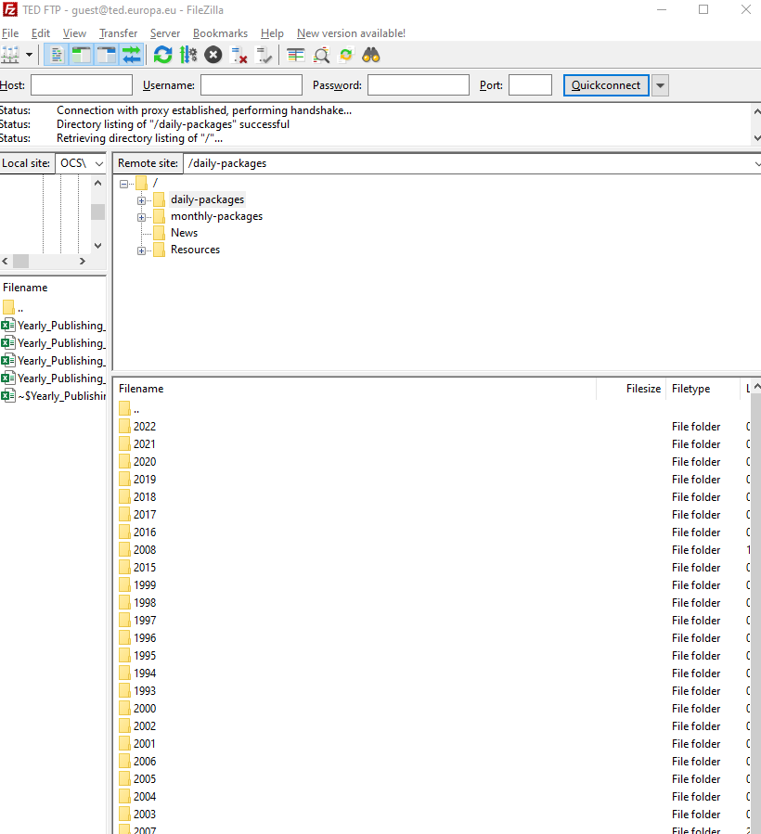
Download XML notices in bulk from the TED FTP server
Daily packages: archives containing all the notices for each day
Monthly packages: archives containing all the notices for each month
Link: ftp://guest:guest@ted.europa.eu

Slide 12
View notices in various formats
TED users will be able to retrieve in both current standard forms and eForms notices
Several options to view notices:
  Direct links (recommended option)
  Based on the content of a notice in XML, you can get the notice in HTML or PDF format, and in a specific language. Two different APIs are available:
    API to view TED schema notices,
    API to view eForms notices.

Slide 13
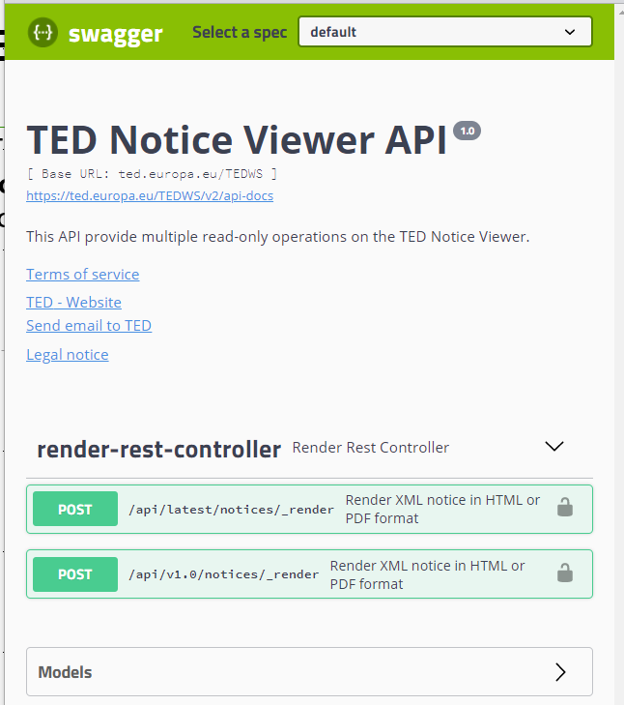
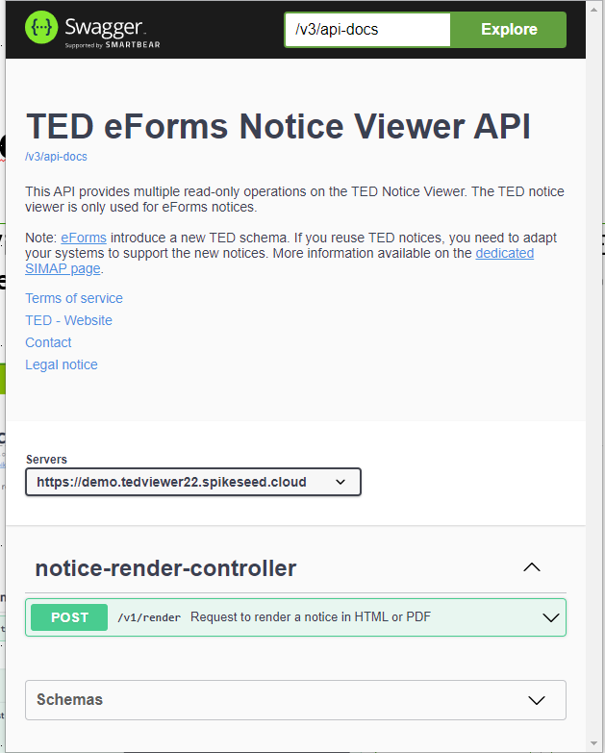
TED viewer – 2 API’s
TED Notice Viewer API will still provide operations to only render TED schema notices in various formats
TED Notice Viewer 2022 API will provide operations to only render eForms notices in various formats

Slide 14
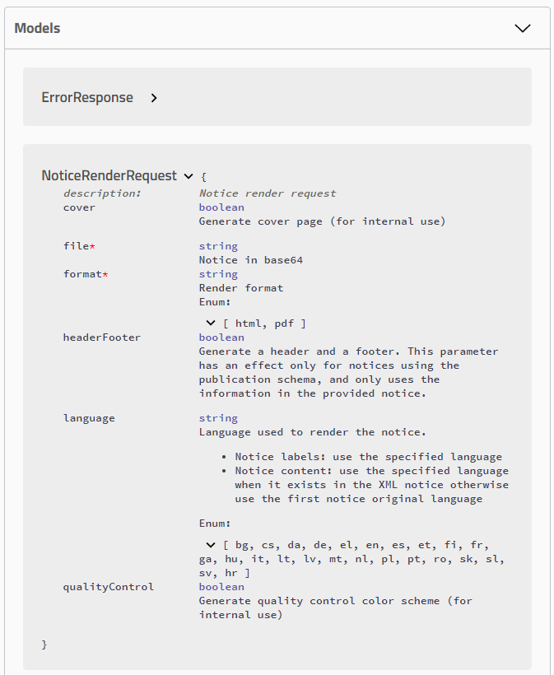
Render notices using
TED Notice Viewer API
Used to only render TED schema notices in various formats
Main parameters:
file - xml of the notice encoded in base 64
format - Values: html, pdf
language: language used to render the notice
Link: https://ted.europa.eu/TEDWS/swagger-ui.html

Slide 15
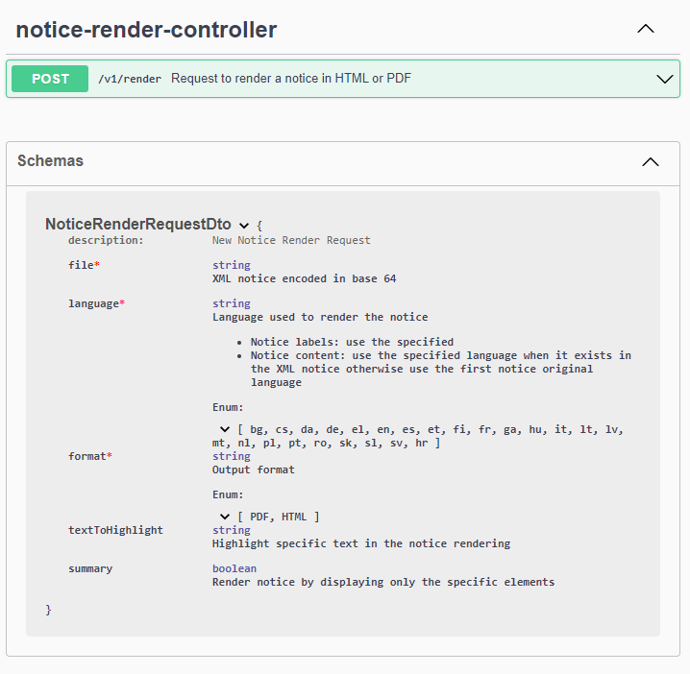
Render notices using
TED Notice Viewer 2022 API
Used to only render eForms notices in various formats
Main parameters:
file - xml notice encoded in base 64
format - Values: HTML, PDF
language: language used to render the notice
Link: https://ted.europa.eu/TEDWS/swagger-ui.html

Slide 16
Demo …

Slide 17

Any questions?
Please ask your question in the chat

